Slide 1
Analyzing packets to demonstrate the vulnerability of LoRaWAN
Team 454P
Seokhyeon Bang
Junyoung Jang
Doyong Kwon
Yuseon Choi
Minju Ro
Jerry Lee
2022 K-SW square mid-presentation

Slide 2






Team Members (454P)
Seokhyeon Bang (Team Leader)
Chung-Ang University
kzrt0123@cau.ac.kr
Doyong Kwon
Kyungpook National University
doyong365@knu.ac.kr
Junyoung Jang
Chung-Ang University
junjang99@cau.ac.kr
Minju Ro
Chung-Ang University
romj98@cau.ac.kr
Yuseon Choi
Chonnam National University
181133@jnu.ac.kr
Jerry Lee
Purdue University
lee3245@purdue.edu

Slide 3
Contents
1. Background
What is LoRa? / What is LoRaWAN?
Advantages of LoRa
Use Cases of LoRa
2. Problem Statement
The Risk of Hacking LoRaWAN
Security issues of LoRaWAN
Goal of 454P
3. Progress
Constructing Local LoRaWAN
Methodology – Jamming
Methodology – Packet Sniffing
4. Project Milestones

Slide 4

Background

Slide 5
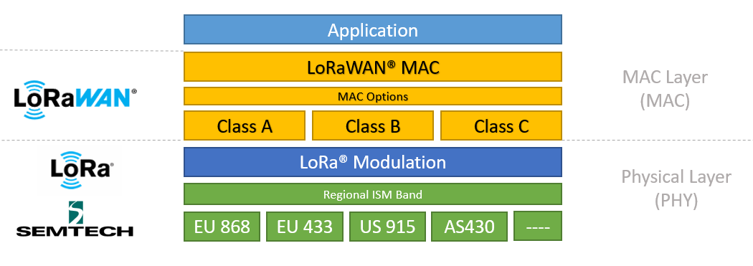
Background
What is LoRa?
Low-Powered Wide Area Network(LPWAN) technology that enables low-power, long-distance data transmission
What is LoRaWAN?
Open networking protocol on top of LoRa
Figure 1: LoRaWAN technology stack
Source: Adapted from [1]

Slide 6
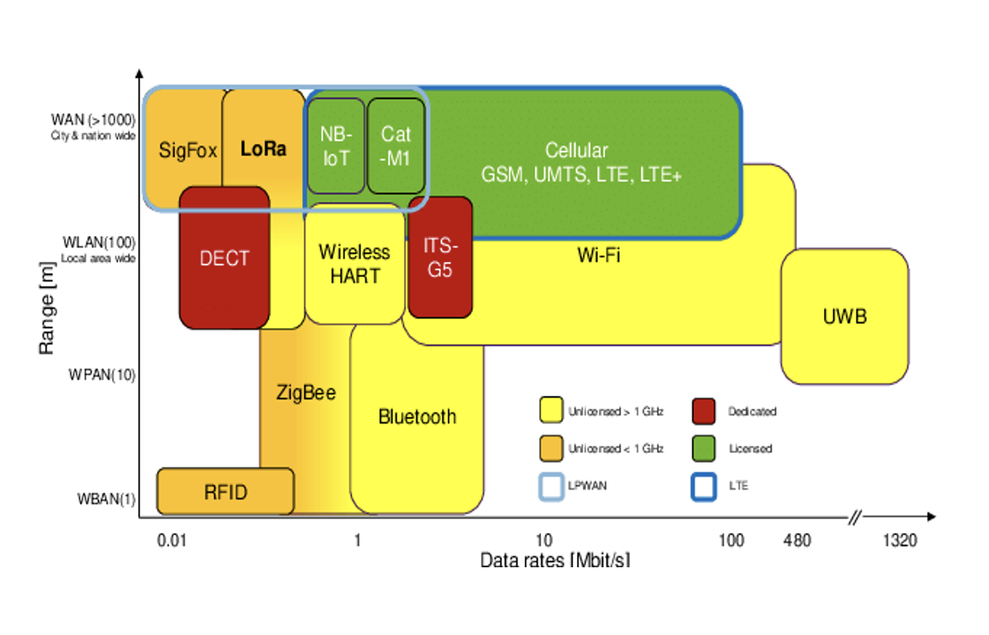
Background
Advantages of LoRa
bi-directional communication, localization, and mobility of services
LoRa vs Wireless communications
Transmit small data to remote areas
Cover a wider area than others (Wi-Fi, Blutetooth, ZigBee)
Easy to build and maintain private networks
Figure 2: Comparsion with LoRa and wireless communications
Source: Adapted from [2]

Slide 7
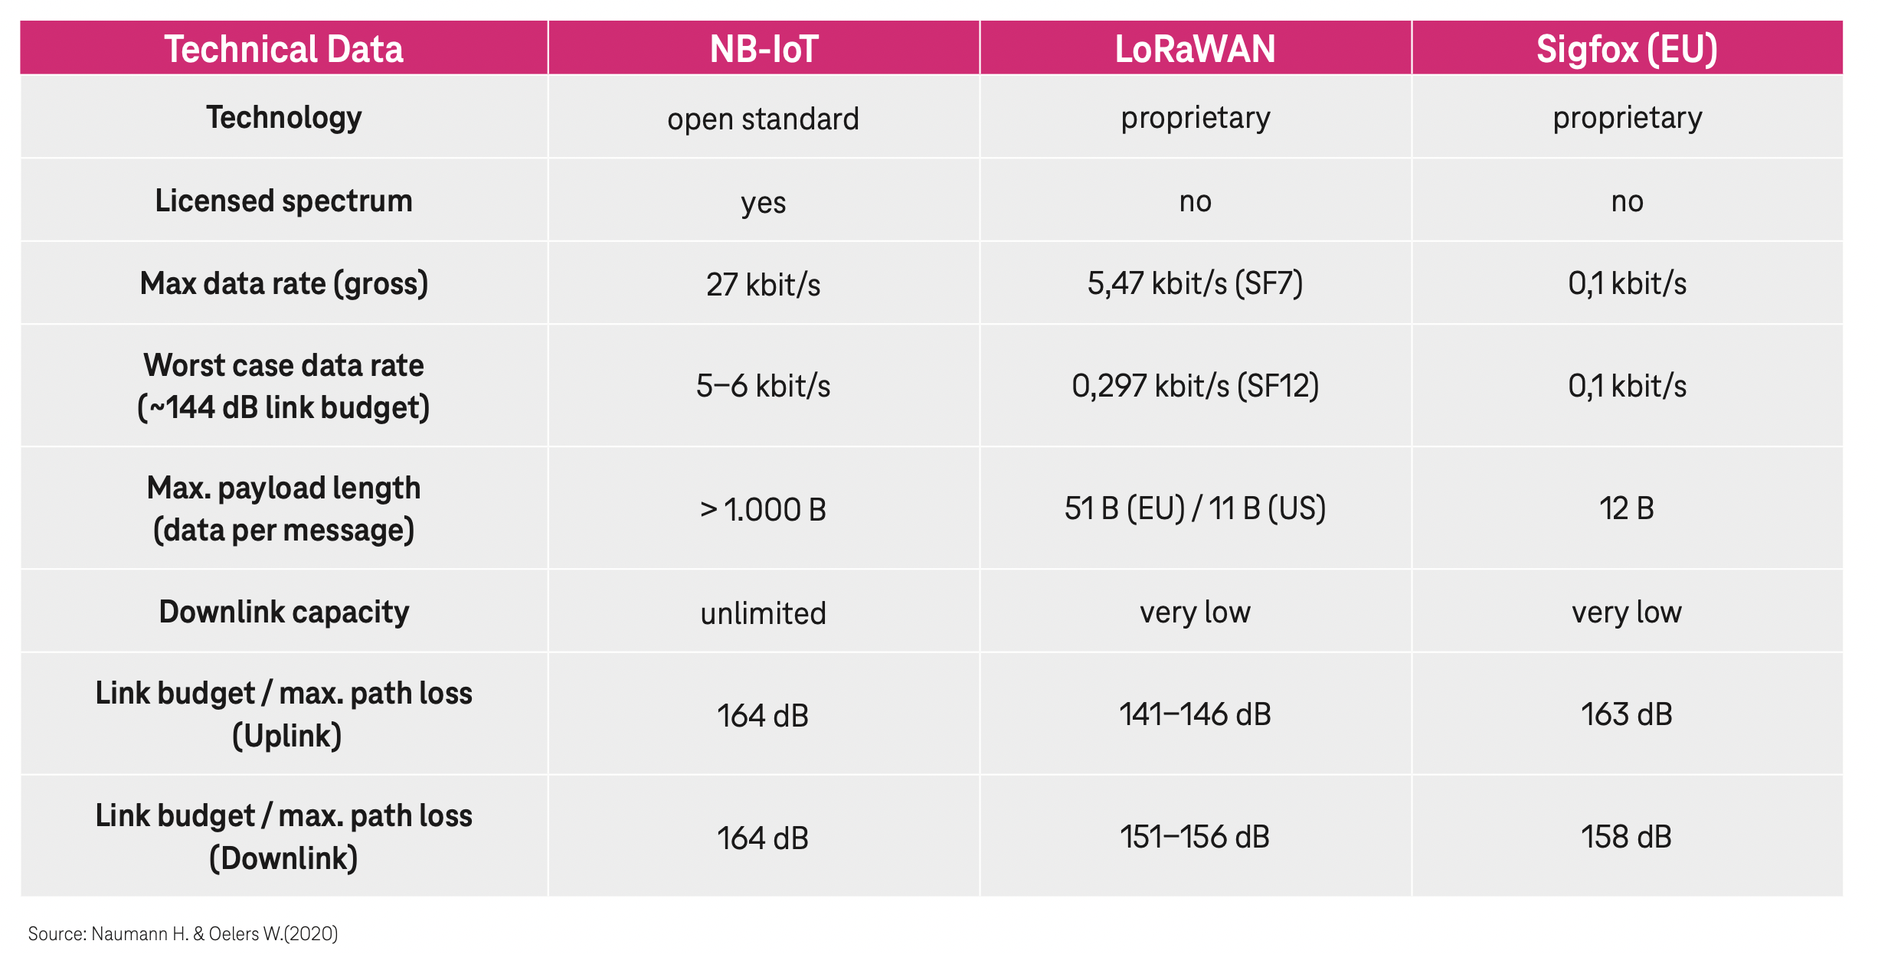
Background
LoRa vs Other LPWAN
Figure 3: Comparsion with LoRa and other LPWANs
Source: Adapted from [3]
consumes less power and lasts the battery for a long time than NB-IoT
has a higher data transmission rate than Sigfox

Slide 8
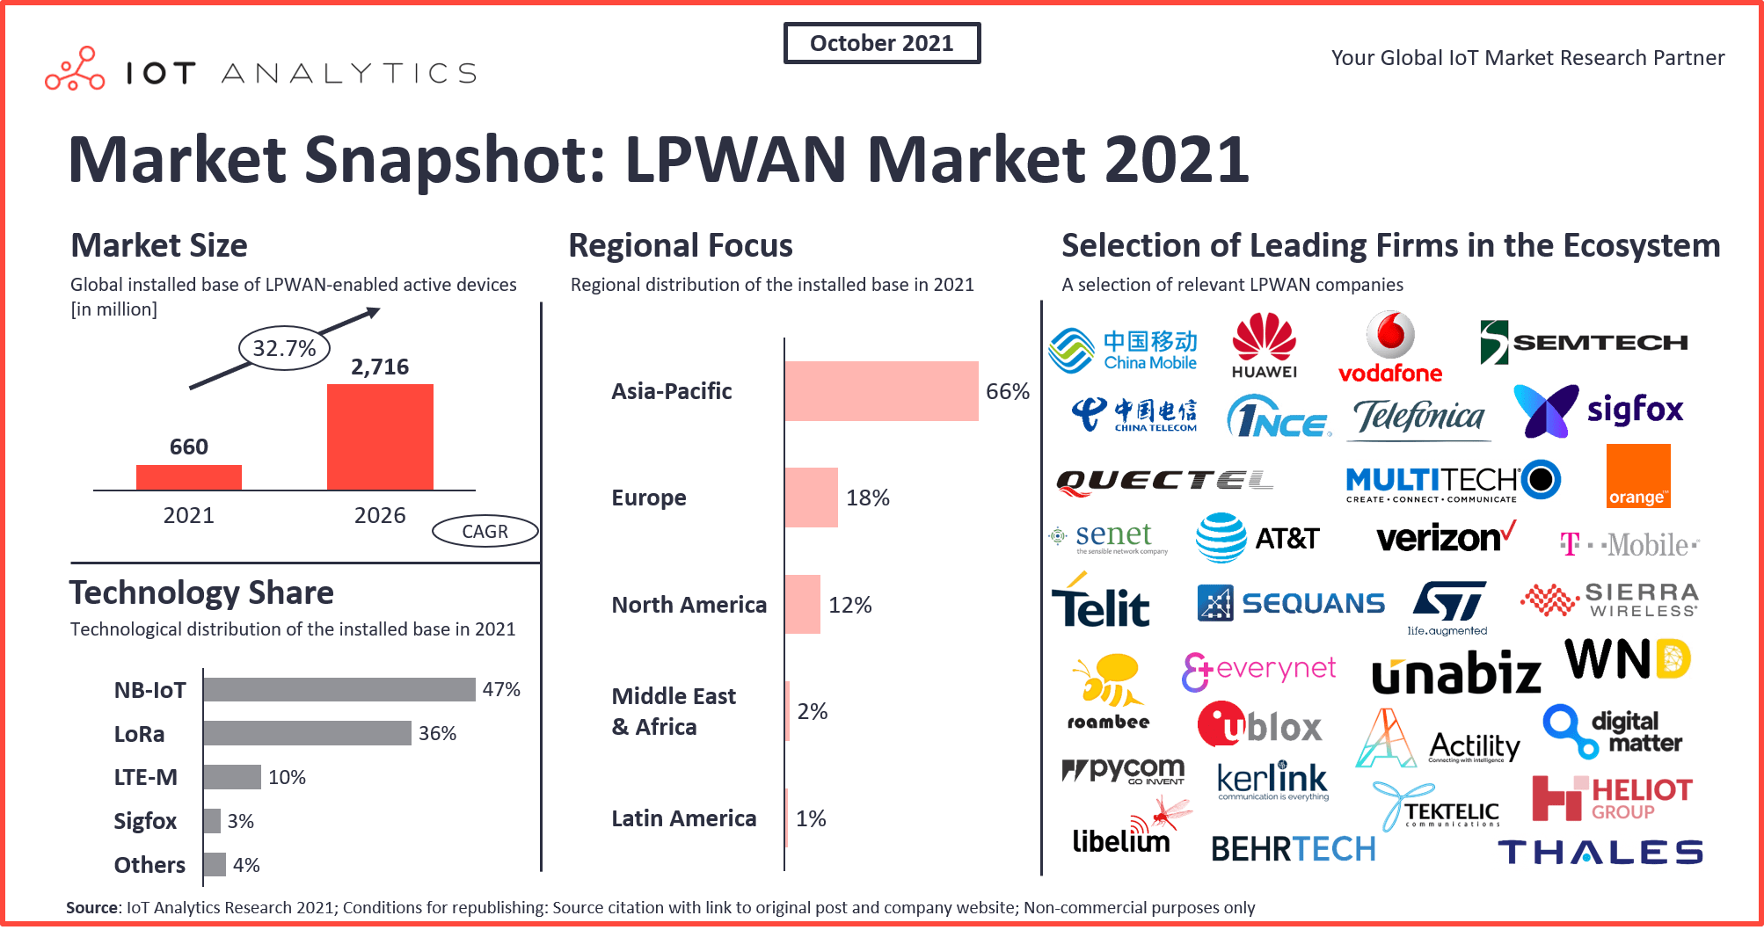
Background
Use Cases of LoRa
smart city
logistics
transportation management
smart healthcare
smart buildings
public safety
space environment
smart agriculture
Figure 4: Market Snapshot. LPWAN Market 2021
Source: Adapted from [4]

Slide 9
Problem Statement

Slide 10

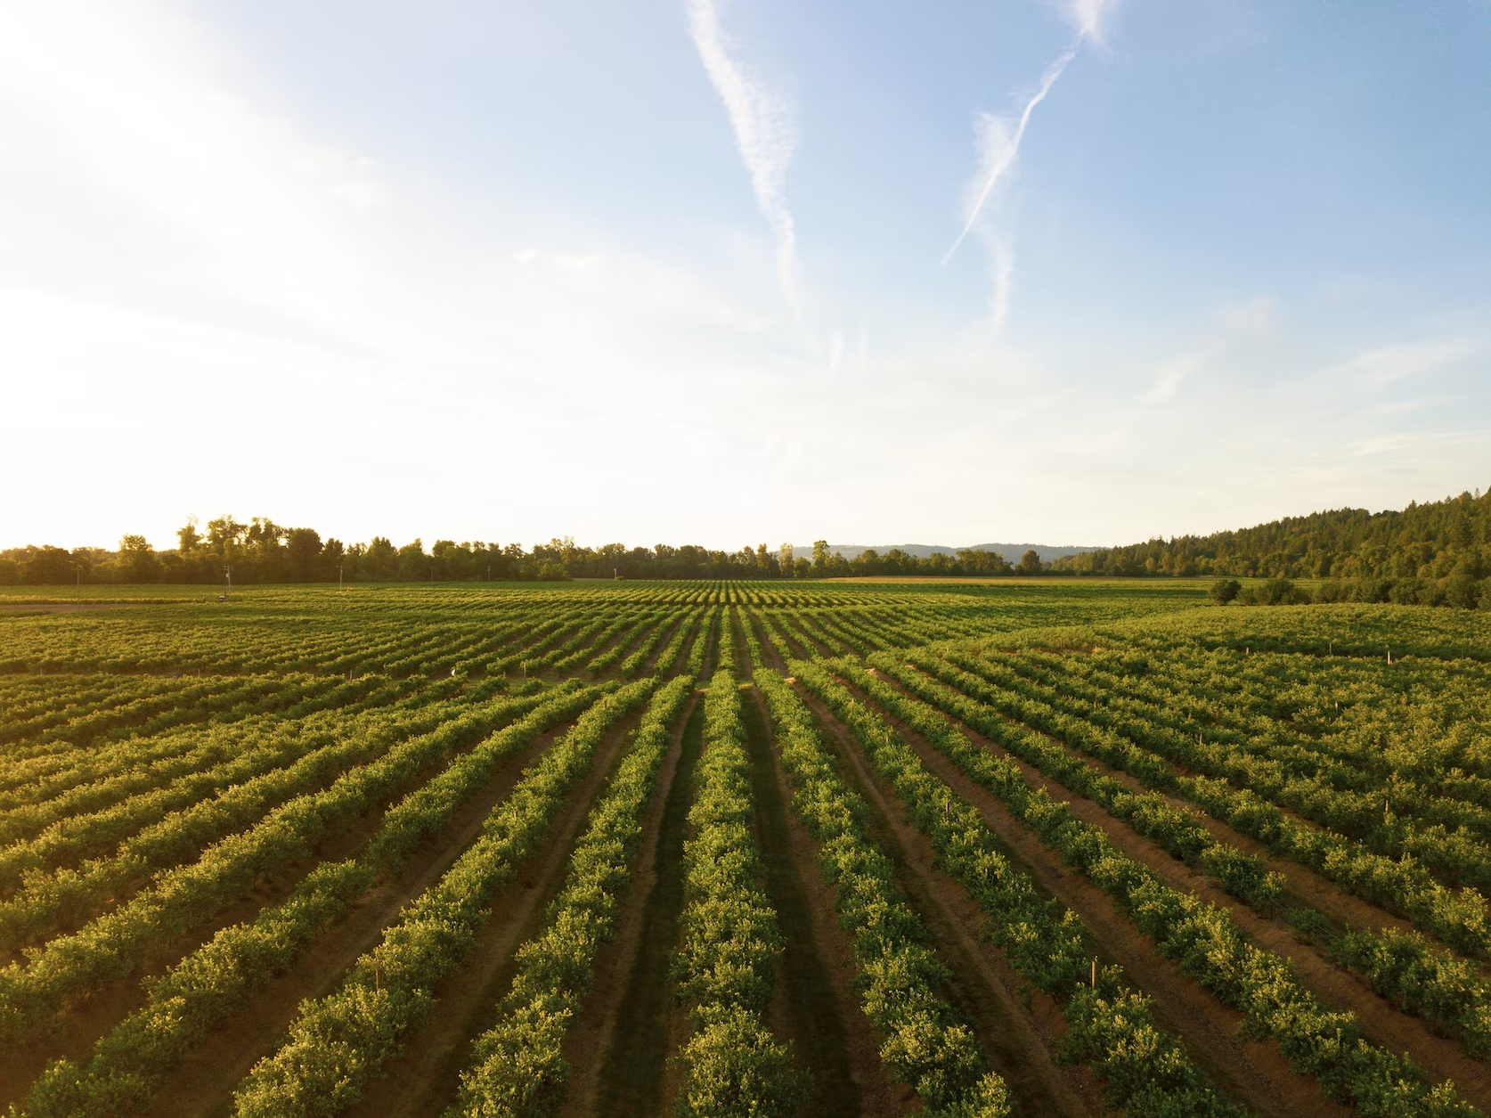
Problem Statement
The Risk of Hacking LoRaWAN
- Information loss can cause life-threatening and financial damage.
Medical Area
Agriculture Area

Slide 11
Problem Statement
Security issues of LoRaWAN
Replay attack
It abuses that the security keys do not change after the counter reset
ACK spoofing
It exploits that LoRaWAN does not specify the sequential number of the ACK message

Slide 12
Problem Statement
Security issues of LoRaWAN
Eavesdropping
It occurs since LoRaWAN uses AES in counter-mode for encryption
​
Bit-flipping attack​
It uses the characteristic that Advanced Encryption Standard(AES) counter-mode encryption is symmetric to recover the plaintext
​

Slide 13
Problem Statement
Security issues of LoRaWAN
LoRa Class B attack​
It accelerates battery exhaustion by increasing the power consumption of the sensor
Conclusion
LoRa is growing very explosively, but lack of research from a security perspective is still existing on LoRaWAN.
Lack of specific guidelines for security research on LoRaWAN.
Accompanying the security vulnerabilities of traditional wireless networks.

Slide 14
Introduction
Goal of 454P
Demonstrating and analyzing the vulnerabilities of the LoRaWAN system
Constructing the environment with fewer external constraints that reflects real-world

Slide 15
Progress

Slide 16
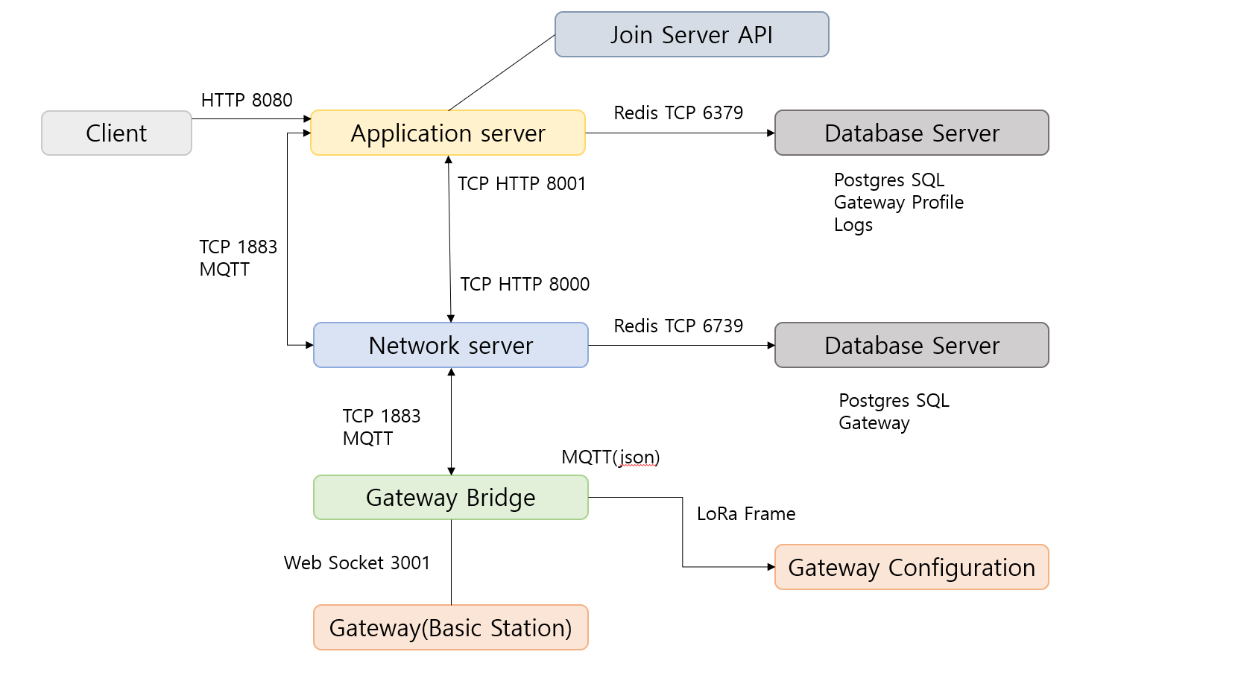
Constructing Local LoRaWAN

Slide 17
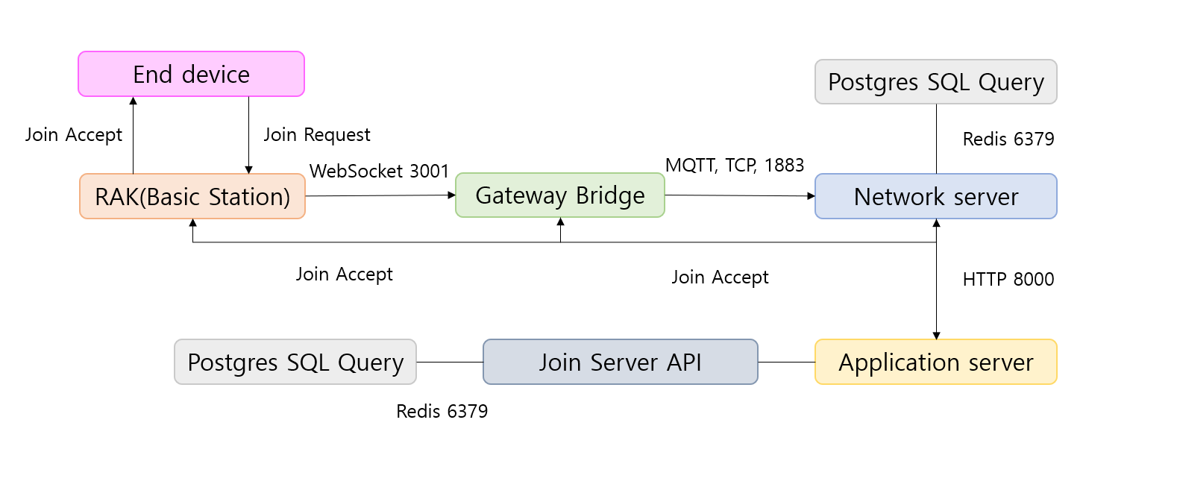
Constructing Local LoRaWAN
Join Request

Slide 18
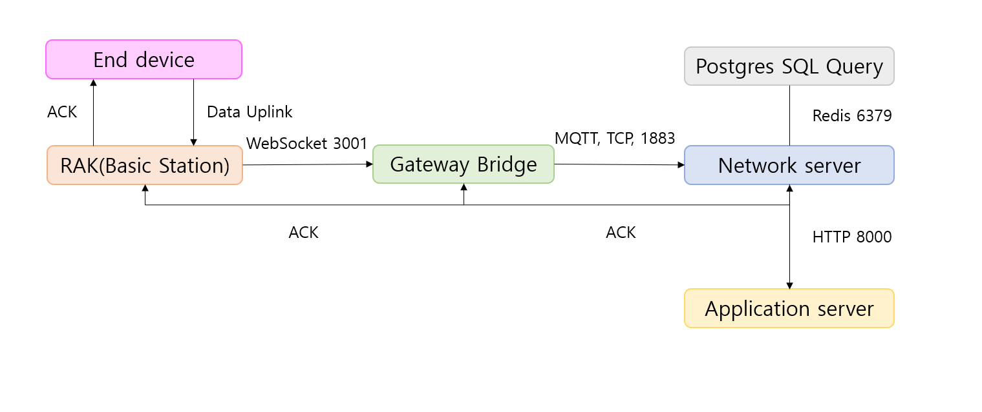
Constructing Local LoRaWAN
Data Uplink
Why local LoRaWAN?
To learn about LoRaWAN mechanism
To hack the LoRaWAN without legal issues

Slide 19
Methodology
Jamming
A technology that prevents the use of certain frequencies or radio waves
by emitting Radio Frequency
Packet transmissions using the corresponding frequency are completely blocked
Experiment details
1. Using Software Define Radio(SDR) with GNU Radio - Reactive Jamming

Slide 20
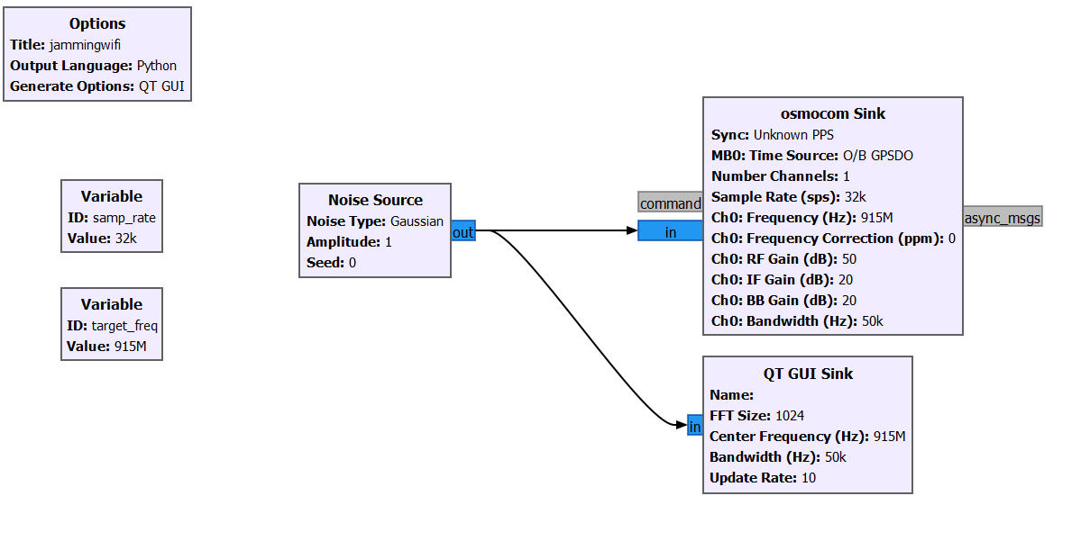
Methodology
Jamming LoRaWAN
Code blocks for jamming using SDR

Slide 21
Methodology
Jamming
A technology that prevents the use of certain frequencies or radio waves
by emitting Radio Frequency
Packet transmissions using the corresponding frequency are completely blocked
Experiment details
1. Using Software Define Radio(SDR) with GNU Radio - Reactive Jamming
2. Using Canopy devices from 20 years ago ($20 each) - Brute Force

Slide 22
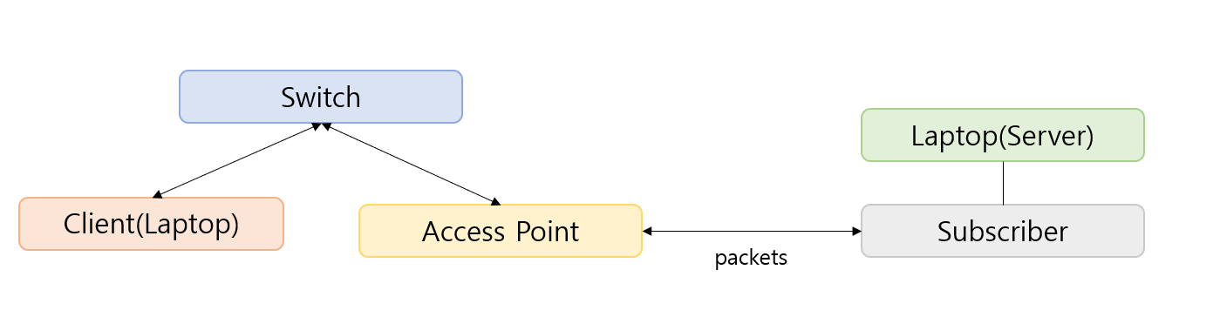
Methodology
Jamming LoRaWAN
Access Point send packets to subscriber working as a barrier

Slide 23
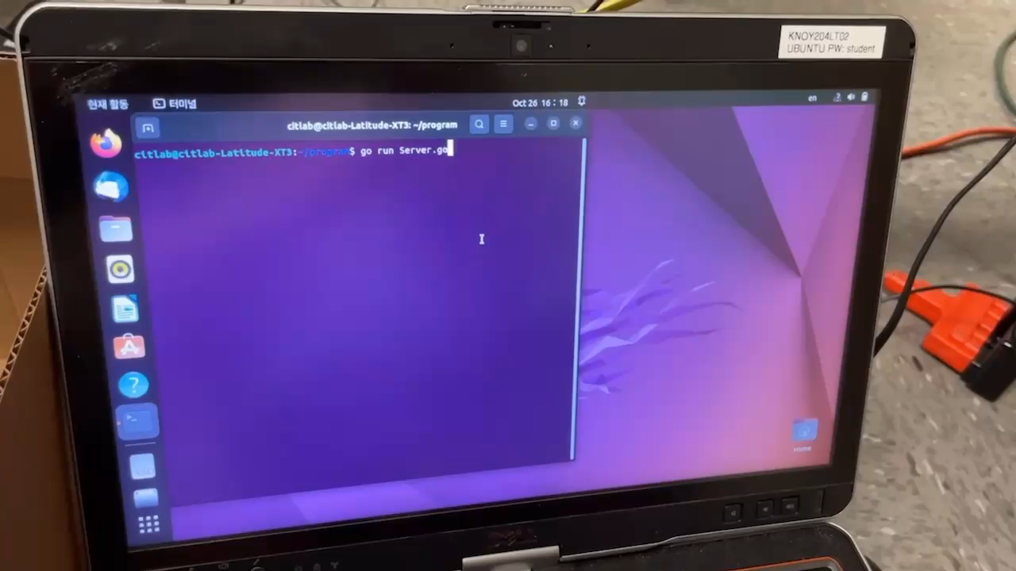
Methodology
Jamming LoRaWAN
Demo Video

Slide 24
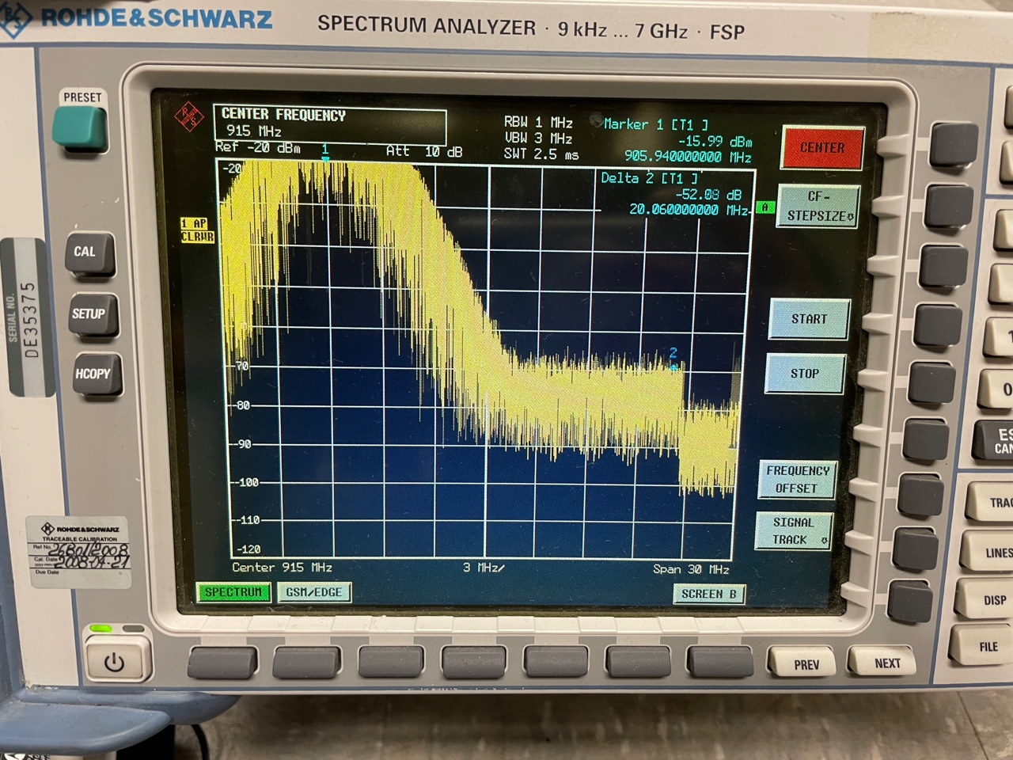
Methodology
Jamming LoRaWAN
Using Motorola Canopy

Slide 25




Methodology
Sniffing
Hacker
Sensor
Sniffing
Gateway
Packet

Slide 26
Methodology
Replay Attack
Maliciously repeating the data
-> Results in a Denial-of-Service attack.
Hacker
Replay Attack
Sensor
Sniffing
Gateway
Packet

Slide 27
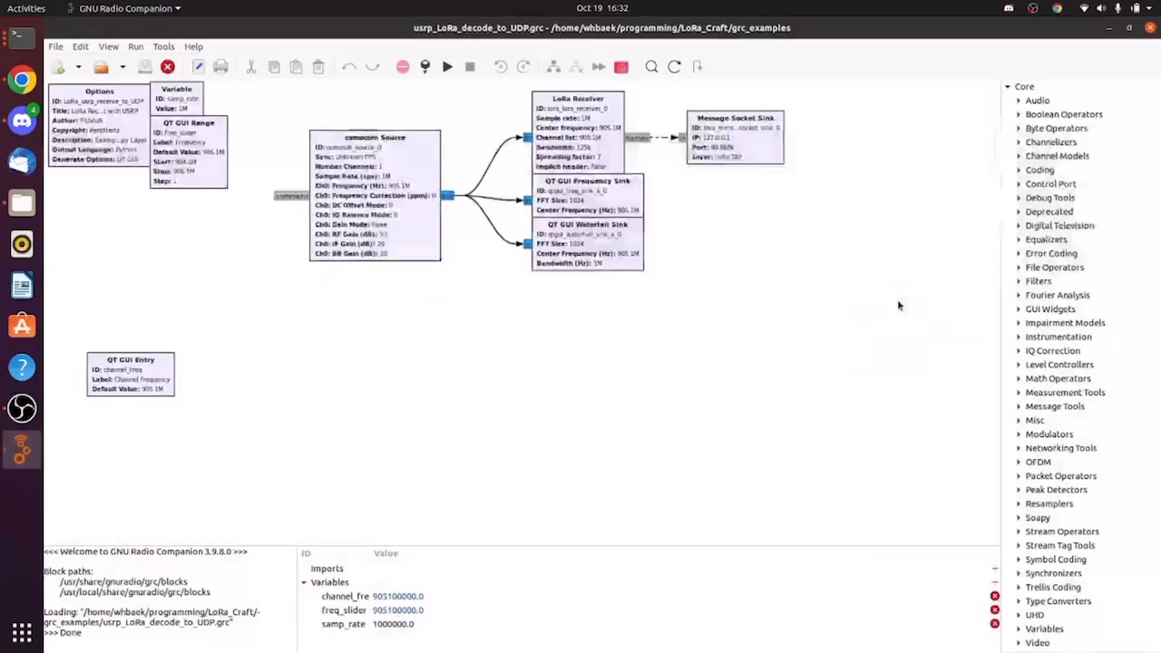
Methodology
Sniffing LoRaWAN

Slide 28
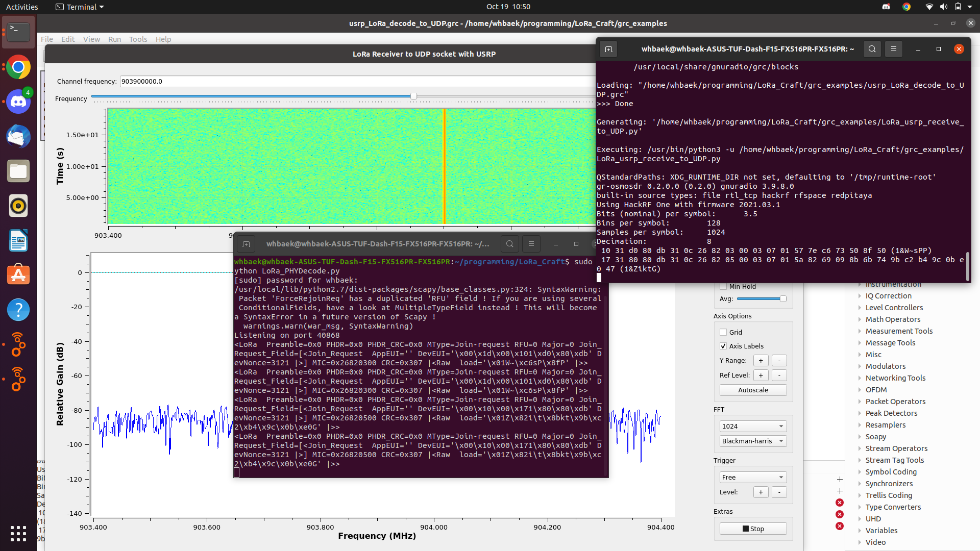
Methodology
Sniffing LoRaWAN

Slide 29
Project Milestone

Slide 30
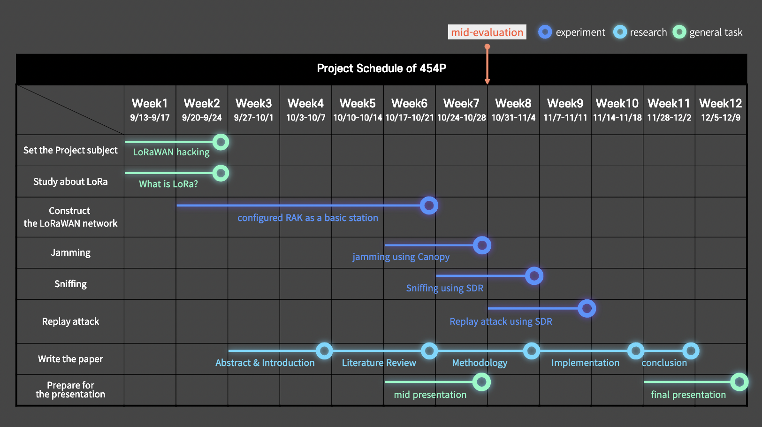
Project Milestones

Slide 31
Reference
[1] Semtech editors. "What are LoRa and LoRaWAN?". semtech.com. https://lora-developers.semtech.com/documentation/tech-papers-and-guides/lora-and-lorawan/ (accessed Oct. 24, 2022).
[2] ResearchGate. "". researchgate.net. https://www.researchgate.net/figure/LoRa-filling-a-gap-for-wireless-communications-LoRa-is-specialized-for-the-requirements_fig2_328372736
[3] Telekom editors. "NB-IoT, LoRaWAN, Sigfox: An up-to-date comparison". telekom.com. https://iot.telekom.com/en/downloads/mobile-iot-network-comparison-nb-iot-lorawan-sigfox (accessed Oct. 25, 2022).
[4] IoT Analytics. "5 things to know about the LPWAN market in 2021". iot-analytics.com. https://iot-analytics.com/5-things-to-know-lpwan-market/ (accessed Oct. 25, 2022).
[5] Semtech, "What are LoRa® and LoRaWAN®,'' lora-developers.semtech.com, https://lora- developers.semtech.com/documentation/tech-papers-and-guides/lora-and-lorawan (accessed Sep. 14, 2022).
[6] F. L. Coman, K. M. Malarski, M. N. Petersen and S. Ruepp, "Security Issues in Internet of Things: Vulnerability Analysis of LoRaWAN, Sigfox and NB-IoT," 2019 Global IoT Summit (GIoTS), 2019, pp. 1-6, doi: 10.1109/GIOTS.2019.8766430.
[7] The Things Industries, "Why you should use lora technology and LoRaWAN® for your next IOT use case,” www.thethingsindustries.com, https://www.thethingsindustries.com/news/why-you-should-use-lora-technology-and-lorawan-for-your-next-iot-use-case/ (accessed Oct. 10, 2022).
[8] X. Yang, E. Karampatzakis, C. Doerr and F. Kuipers, "Security Vulnerabilities in LoRaWAN," 2018 IEEE/ACM Third Int. Conf. on Internet-of-Things Design and Implementation (IoTDI), 2018, pp. 129-140, doi: 10.1109/IoTDI.2018.00022.
[9] IoActive, "LoRaWAN Networks Susceptible to Hacking: Common Cyber Security Problems, How to Detect and Prevent Them.", act-on.ioactive.com, https://act-on.ioactive.com/acton/attachment/34793/f-87b45f5f -f181-44fc-82a8-8e53c501dc4e/1/-/-/-/-/LoRaWAN\%20Networks\%20Susceptible\%20to\%20Hacking.pdf (accessed Oct. 14, 2022).

Slide 32
Q & A
Team 454P
2022 K-SW square mid-presentation

Slide 33
Thank you
Team 454P
2022 K-SW square mid-presentation

Slide 34
Constructing Local LoRaWAN
Configuration Settings
Gateway Bridge
Raspbian OS@latest
ChirpStack v3@latest
Mosquitto@latest
Network Server & Application Server
Raspbian OS@latest
ChirpStack v3@latest
Redis: 5.0.
Mosquitto@latest
PostgreSQL: 9.5.

Slide 35
Configuring GNU Radio + LoRa Packet UDP Reader
Configuration Settings
Ubuntu: 20.04
GNU Radio 3.8/3.9
LoRa_Craft
python: 3.7.3
from python: 3.7.3 scapy@latest
GNU Radio: 3.8.5
Gr-LoRa
python: 2
from python: 2 numpy scipy
swig
cppunit
fftw
gnuradio: 3.8.5
libvolk
log4cpp
cmake
Wx
liquid-dsp
Gr-osmosdr (HackRF Connection)
libhackrf
gnuradio:3.9
HackRF one (SDR)

Slide 36
Methodology
Kracking
Nonce attack
Injection
Bit flipping

